Slide 1

Agile Dead Trees
Group 7: Bryan McCann, Jordan Chandler, Steve Shoemaker, Sachin Ghaste
CS 7346
July 26, 2023

Slide 2

Agile Dead Trees
Agile Dead Trees is a website designed to unify uploading, reviewing, and delivering e-books to customers. Authors can upload copies, editors can review them, and customers can purchase and read e-books. Our solution is a cloud-based Content Management System that allows authors and publishers to get their books to customers. We leverage Amazon Web Services for our solution, especially Elastic Container Service, Document DB, S3 and CloudFront.

Slide 3
Requirements
Functional Requirements
Authors can submit chapters and books for review
Reviewers can see the chapters, make review comments, and notify authors on review
Authors can reject or accept proposed review changes
Reviewers can make both copy and technical edits
Customers can buy books (e-book or physical)
Publishers can release ‘beta’ chapters to customers, early copies of chapters that will be released at a future time
Administrators can create, delete, and manage accounts for Publishers, Reviewers and Author accounts.
Nonfunctional Requirements
99.99% uptime on the whole solution, or ~53 minutes a year
Copies themselves are available forever and will not be lost

Slide 4
Assumptions
Our solution just needs to track which customers have purchased which books, other Back End Accounting will be managed by the publisher itself, including paying authors, royalties, licensing etc.…
We will use an out of the box payment processing system, Stripe, to handle customer payments.
Publisher Administrators have the information they need to create publisher, reviewer, and author accounts.
Publisher handles delivery of physical copies of books
The customer wants to get the product to market quickly, performance and price are not as important as key features and development speed.
The solution excludes development of software components and APIs used in architecture assuming that it will be available.

Slide 5
Stakeholders
Users
Authors
Publisher

Slide 6
Use Cases: Publishers
Can create Publisher, Author and Reviewer accounts
Can manage Publisher, Author, and Reviewer accounts
Assign reviewers to authors
Publish books and beta chapters for sale to customers

Slide 7
Use Cases: Reviewers
Can view available manuscripts to review
Can leave comments and suggest changes to manuscripts for authors
Can recommend manuscripts to be published if they view it is ready

Slide 8
Use Cases: Authors
Can view their manuscripts.
Can submit manuscripts for review.
Can submit manuscripts for release.
Can edit their manuscripts.
Can accept/reject review changes.

Slide 9
Use Cases: Customer
Can view available manuscripts.
Can order physical copies to be shipped.
Can manage account info such as email, password, contact information.
Can purchase books and beta chapters.
Can look up manuscripts to purchase.

Slide 10
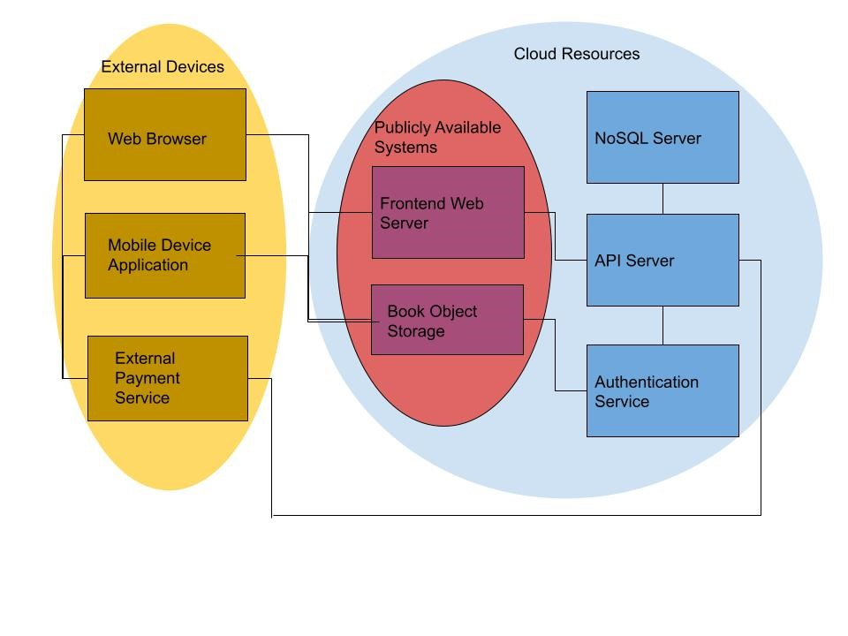
Architecture Diagram

Slide 11

Cloud Services Used
Amazon ECS
Amazon ECR
Amazon Cognito
Amazon CloudFront
Amazon s3
Route 53
AWS Shield
AWS Centralized Logging
AWS CloudWatch
Document DB

Slide 12
Expected Changes
AWS changes, especially security or cost (Medium Frequency)
Mobile device updates (High Frequency)
Browser feature changes ( Low Frequency)
Expanding of writing, reading, and editing features (High Frequency)
Expanding book marketplace features (Medium Frequency)

Slide 13

Operating Risks and Mitigations
High Demand
DDoS
Malicious Internal Actors
Piracy
Payment Fraud
Server Outage
Data Breaches

Slide 14

Questions

